Slide 1
BLM267
Chapter 6: Linked Lists

Slide 2
Doubly Linked Lists
Circular Doubly Linked Lists
Multi-linked Lists
Application of Linked Lists

Slide 3
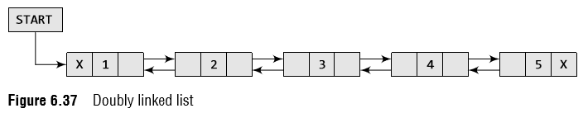
Doubly Linked Lists
A doubly linked list or a two-way linked list is a more complex type of linked list which contains a pointer to the next as well as the previous node in the sequence.
Therefore, it consists of three parts—data, a pointer to the next node, and a pointer to the previous node as shown in Fig. 6.37.

Slide 4
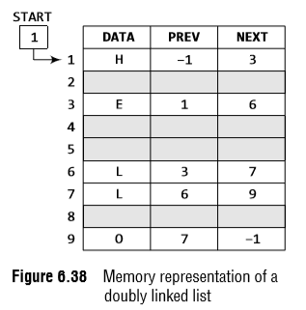
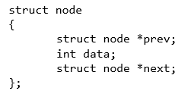
Doubly Linked Lists
The PREV field of the first node and the NEXT field of the last node will contain NULL.
The PREV field is used to store the address of the preceding node, which enables us to traverse the list in the backward direction.
Thus, we see that a doubly linked list calls for more space per node and more expensive basic operations.
However, a doubly linked list provides the ease to manipulate the elements of the list as it maintains pointers to nodes in both the directions (forward and backward).
The main advantage of using a doubly linked list is that it makes searching twice as efficient.

Slide 5
Doubly Linked Lists
Inserting a new node in a doubly Linked List
In this section, we will discuss how a new node is added into an already existing doubly linked list.
We will take four cases and then see how insertion is done in each case.
Case 1: The new node is inserted at the beginning.
Case 2: The new node is inserted at the end.
Case 3: The new node is inserted after a given node.
Case 4: The new node is inserted before a given node.

Slide 6
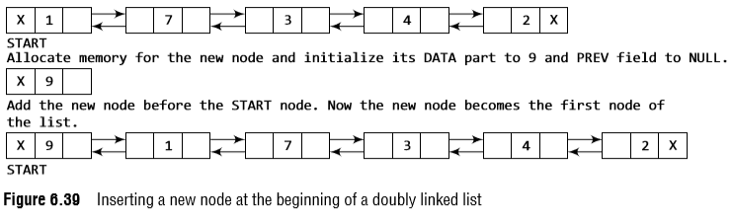
Doubly Linked Lists
Inserting a Node at the Beginning of a Doubly Linked List
Consider the doubly linked list shown in Fig. 6.39.
Suppose we want to add a new node with data 9 as the first node of the list.
Then the following changes will be done in the linked list.

Slide 7
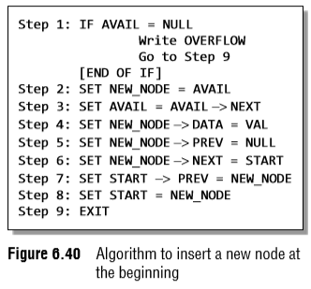
Doubly Linked Lists
Inserting a Node at the Beginning of a Doubly Linked List
Figure 6.40 shows the algorithm to insert a new node at the beginning of a doubly linked list.
Set its DATA part with the given VAL and the NEXT part is initialized with the address of the first node of the list, which is stored in START.
Now, since the new node is added as the first node of the list, it will now be known as the START node, that is, the START pointer variable will now hold the address of NEW_NODE.

Slide 8
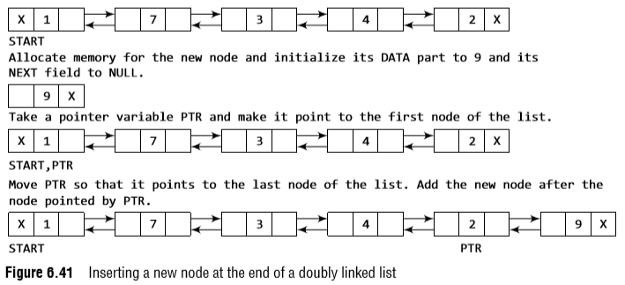
Doubly Linked Lists
Inserting a Node at the End end of a Doubly Linked List
Consider the doubly linked list shown in Fig. 6.41.
Suppose we want to add a new node with data 9 as the last node of the list.
Then the following changes will be done in the linked list.

Slide 9
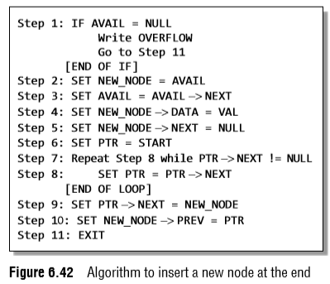
Doubly Linked Lists
Inserting a Node at the End end of a Doubly Linked List
Figure 6.42 shows the algorithm to insert a new node at the end of a doubly linked list.
In Step 6, we take a pointer variable PTR and initialize it with START. In the while loop, we traverse through the linked list to reach the last node.
Once we reach the last node, in Step 9, we change the NEXT pointer of the last node to store the address of the new node.
Remember that the NEXT field of the new node contains NULL which signifies the end of the linked list.
The PREV field of the NEW_NODE will be set so that it points to the node pointed by PTR (now the second last node of the list).

Slide 10
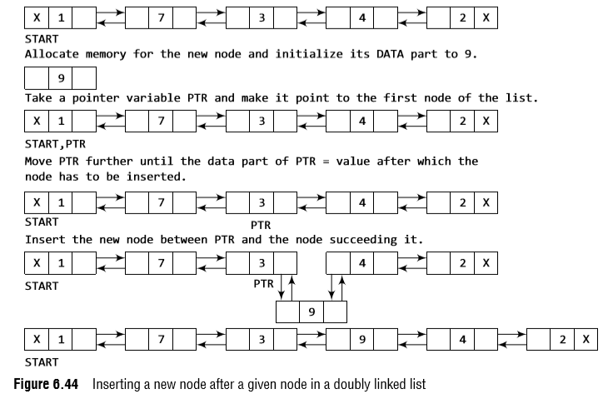
Doubly Linked Lists
Inserting a Node After a Given Node in a Doubly Linked List
Consider the doubly linked list shown in Fig. 6.44.
Suppose we want to add a new node with value 9 after the node containing 3.

Slide 11
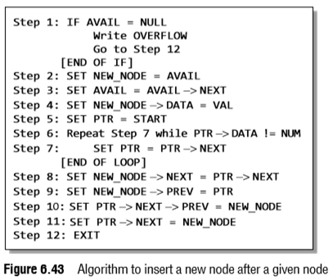

Doubly Linked Lists
Inserting a Node After a Given Node in a Doubly Linked List
Figure 6.43 shows the algorithm to insert a new node after a given node in a doubly linked list.
In Step 5, we take a pointer PTR and initialize it with START.
In the while loop, we traverse through the linked list to reach the node that has its value equal to NUM.
We need to reach this node because the new node will be inserted after this node.
Once we reach this node, we change the NEXT and PREV fields in such a way that the new node is inserted after the desired node.

Slide 12
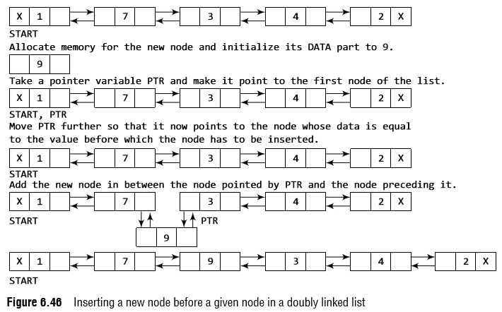
Doubly Linked Lists
Inserting a Node Before a Given Node in a Doubly Linked List
Consider the doubly linked list shown in Fig. 6.46.
Suppose we want to add a new node with value 9 before the node containing 3.

Slide 13
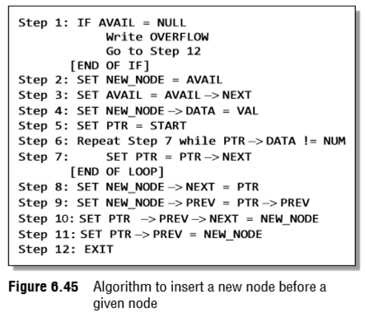

Doubly Linked Lists
Inserting a Node Before a Given Node in a Doubly Linked List
In Step 5, we take a pointer variable PTR and initialize it with START.
That is, PTR now points to the first node of the linked list.
In the while loop, we traverse through the linked list to reach the node that has its value equal to NUM.
We need to reach this node because the new node will be inserted before this node.
Once we reach this node, we change the NEXT and PREV fields in such a way that the new node is inserted before the desired node.

Slide 14
Doubly Linked Lists
Deleting a node from a doubly Linked List
In this section, we will see how a node is deleted from an already existing doubly linked list.
We will take four cases and then see how deletion is done in each case.
Case 1: The first node is deleted.
Case 2: The last node is deleted.
Case 3: The node after a given node is deleted.
Case 4: The node before a given node is deleted.

Slide 15
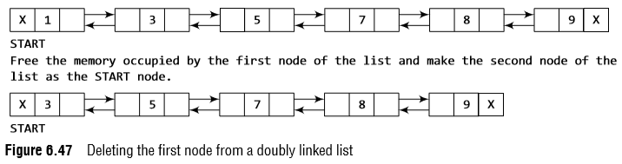
Doubly Linked Lists
Deleting the First Node from a Doubly Linked List
Consider the doubly linked list shown in Fig. 6.47.
When we want to delete a node from the beginning of the list, then the following changes will be done in the linked list.

Slide 16
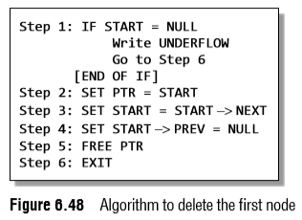
Doubly Linked Lists
Deleting the First Node from a Doubly Linked
ListFigure 6.48 shows the algorithm to delete the first node of a doubly linked list.
In Step 1 of the algorithm, we check if the linked list exists or not.
If START = NULL, then it signifies that there are no nodes in the list and the control is transferred to the last statement of the algorithm.
However, if there are nodes in the linked list, then we use a temporary pointer variable PTR that is set to point to the first node of the list.
For this, we initialize PTR with START that stores the address of the first node of the list.
In Step 3, START is made to point to the next node in sequence and finally the memory occupied by PTR (initially the first node of the list) is freed and returned to the free pool.

Slide 17
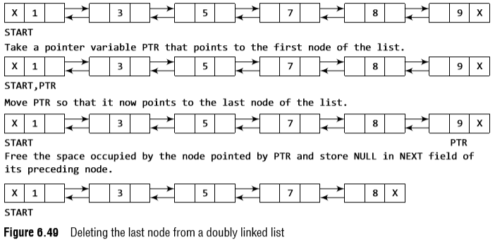
Doubly Linked Lists
Deleting the Last Node from a Doubly Linked List
Consider the doubly linked list shown in Fig. 6.49.
Suppose we want to delete the last node from the linked list, then the following changes will be done in the linked list.

Slide 18
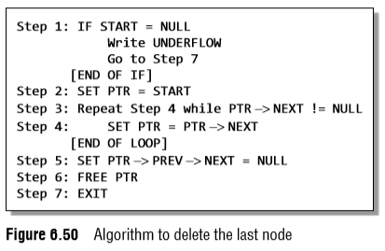
Doubly Linked Lists
Deleting the Last Node from a Doubly Linked List
Figure 6.50 shows the algorithm to delete the last node of a doubly linked list.
In Step 2, we take a pointer variable PTR and initialize it with START.
That is, PTR now points to the first node of the linked list.
The while loop traverses through the list to reach the last node.
Once we reach the last node, we can also access the second last node by taking its address from the PREV field of the last node.
To delete the last node, we simply have to set the next field of second last node to NULL, so that it now becomes the (new) last node of the linked list.
The memory of the previous last node is freed and returned to the free pool.

Slide 19
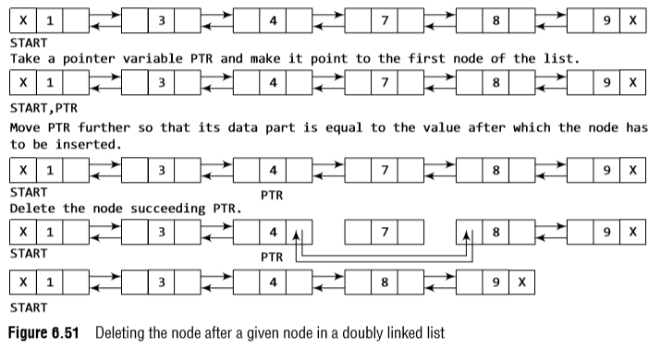
Doubly Linked Lists
Deleting the Node After a Given Node in a Doubly Linked List
Consider the doubly linked list shown in Fig. 6.51.
Suppose we want to delete the node that succeeds the node which contains data value 4.
Then the following changes will be done in the linked list.

Slide 20
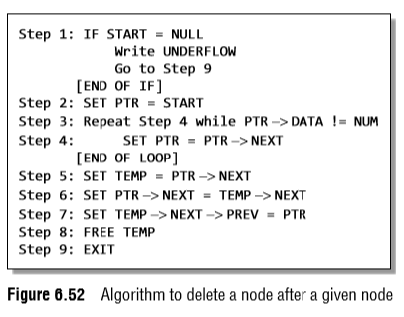

Doubly Linked Lists
Deleting the Node After a Given Node in a Doubly Linked List
Figure 6.52 shows the algorithm to delete a node after a given node of a doubly linked list.
In Step 2, we take a pointer variable PTR and initialize it with START.
That is, PTR now points to the first node of the doubly linked list.
The while loop traverses through the linked list to reach the given node.
Once we reach the node containing VAL, the node succeeding it can be easily accessed by using the address stored in its NEXT field.
The NEXT field of the given node is set to contain the contents in the NEXT field of the succeeding node.
Finally, the memory of the node succeeding the given node is freed.

Slide 21
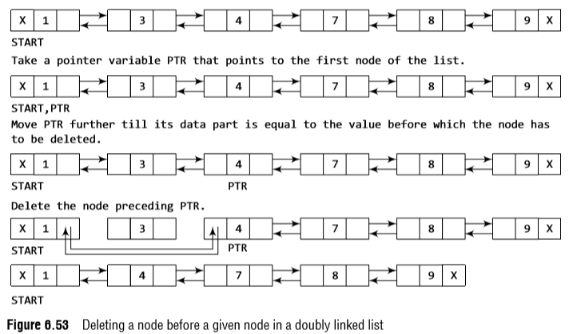
Doubly Linked Lists
Deleting the Node Before a Given Node in a Doubly Linked List
Consider the doubly linked list shown in Fig. 6.53.
Suppose we want to delete the node preceding the node with value 4.

Slide 22
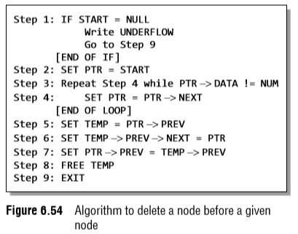

Doubly Linked Lists
Deleting the Node Before a Given Node in a Doubly Linked List
The while loop traverses through the linked list to reach the desired node.
Once we reach the node containing VAL, the PREV field of PTR is set to contain the address of the node preceding the node which comes before PTR.
The memory of the node preceding PTR is freed and returned to the free pool.

Slide 23
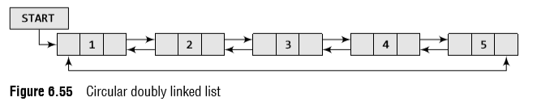
Circular Doubly Linked Lists
A circular doubly linked list or a circular two-way linked list is a more complex type of linked list which contains a pointer to the next as well as the previous node in the sequence.
The difference between a doubly linked and a circular doubly linked list is same as that exists between a singly linked list and a circular linked list.
The circular doubly linked list does not contain NULL in the previous field of the first node and the next field of the last node.
Rather, the next field of the last node stores the address of the first node of the list, i.e., START.

Slide 24
Circular Doubly Linked Lists
Inserting a new node in a circular doubly Linked List
In this section, we will see how a new node is added into an already existing circular doubly linked list.
We will take two cases and then see how insertion is done in each case.
Rest of the cases are similar to that given for doubly linked lists.
Case 1: The new node is inserted at the beginning.
Case 2: The new node is inserted at the end.

Slide 25
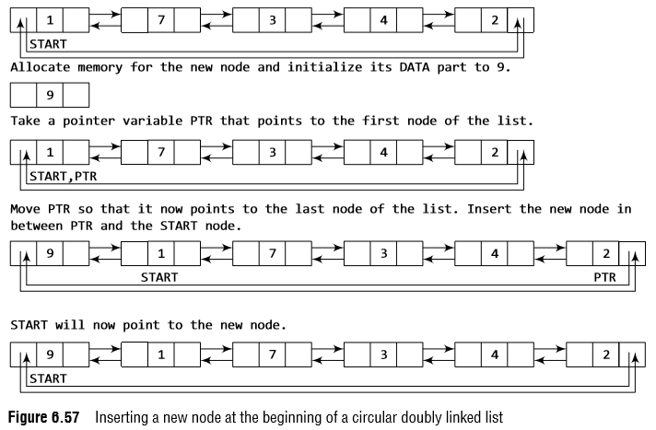
Circular Doubly Linked Lists
Inserting a Node at the Beginning of a Circular Doubly Linked List
Consider the circular doubly linked list shown in Fig. 6.57.
Suppose we want to add a new node with data 9 as the first node of the list.
Then, the following changes will be done in the linked list.

Slide 26
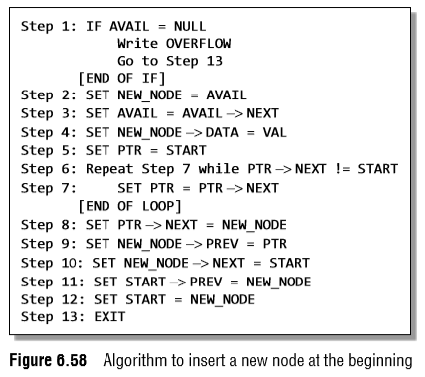

Circular Doubly Linked Lists
Figure 6.58 shows the algorithm to insert a new node at the beginning of a circular doubly linked list.
Next part of the new node is initialized with the address of the first node of the list, which is stored in START.
Now since the new node is added as the first node of the list, it will now be known as the START node, that is, the START pointer variable will now hold the address of NEW_NODE.
Since it is a circular doubly linked list, the PREV field of the NEW_NODE is set to contain the address of the last node.

Slide 27
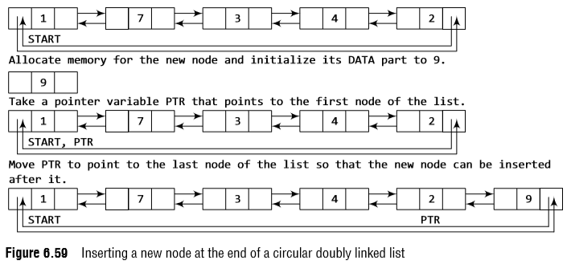
Circular Doubly Linked Lists
Inserting a Node at the End of a Circular Doubly Linked List
Consider the circular doubly linked list shown in Fig. 6.59.
Suppose we want to add a new node with data 9 as the last node of the list.
Then the following changes will be done in the linked list.

Slide 28
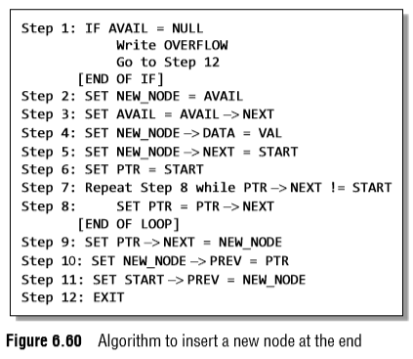

Circular Doubly Linked Lists
Figure 6.60 shows the algorithm to insert a new node at the end of a circular doubly linked list.
In Step 6, we take a pointer variable PTR and initialize it with START.
That is, PTR now points to the first node of the linked list. In the while loop, we traverse through the linked list to reach the last node.
Once we reach the last node, in Step 9, we change the NEXT pointer of the last node to store the address of the new node.
The PREV field of the NEW_NODE will be set so that it points to the node pointed by PTR (now the second last node of the list).

Slide 29
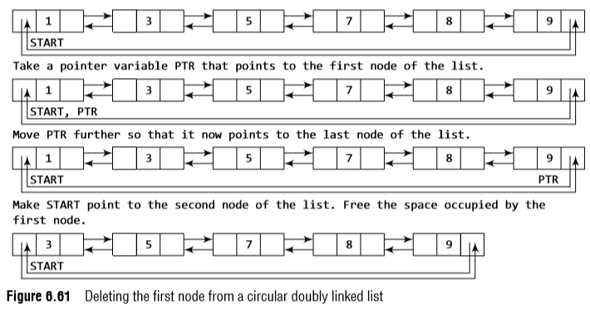
Circular Doubly Linked Lists
Deleting the First Node from a Circular Doubly Linked List
Consider the circular doubly linked list shown in Fig. 6.61.
When we want to delete a node from the beginning of the list, then the following changes will be done in the linked list.

Slide 30
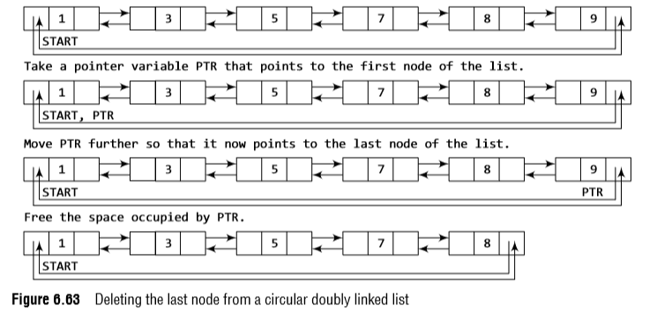
Circular Doubly Linked Lists
Deleting the Last Node from a Circular Doubly Linked List
Consider the circular doubly linked list shown in Fig. 6.63.
Suppose we want to delete the last node from the linked list, then the following changes will be done in the linked list.

Slide 31
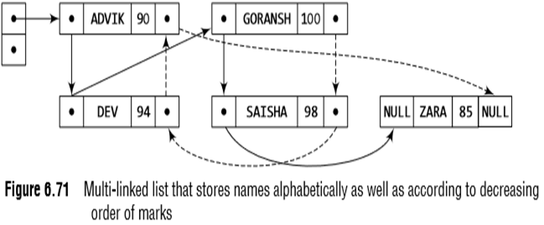
Multi-Linked Lists
Multi-linked lists are generally used to organize multiple orders of one set of elements.
For example, if we have a linked list that stores name and marks obtained by students in a class, then we can organize the nodes of the list in two ways:
(i) Organize the nodes alphabetically (according to the name)
(ii) Organize the nodes according to decreasing order of marks
Figure 6.71 shows a multi-linked list in which students’ nodes are organized by both the aforementioned ways.

Slide 32
Multi-Linked Lists
In a multi-linked list, each node can have n number of pointers to other nodes.
A doubly linked list is a special case of multi-linked lists.
However, unlike doubly linked lists, nodes in a multilinked list may or may not have inverses for each pointer.
We can differentiate a doubly linked list from a multi-linked list in two ways:
(a)
A doubly linked list has exactly two pointers.
One pointer points to the previous node and the other points to the next node.
But a node in the multi-linked list can have any number of pointers.
(b)
In a doubly linked list, pointers are exact inverses of each other, i.e., for every pointer which points to a previous node there is a pointer which points to the next node.
This is not true for a multi-linked list.

Slide 33

Applications of Linked Lists
Polynomial representation
Let us see how a polynomial is represented in the memory using a linked list.
Consider a polynomial 6x³ + 9x² + 7x + 1.
Every individual term in a polynomial consists of two parts, a coefficient and a power.
Here, 6, 9, 7, and 1 are the coefficients of the terms that have 3, 2, 1, and 0 as their powers respectively.
Every term of a polynomial can be represented as a node of the linked list.
Figure 6.74 shows the linked representation of the terms of the above polynomial.

Slide 34
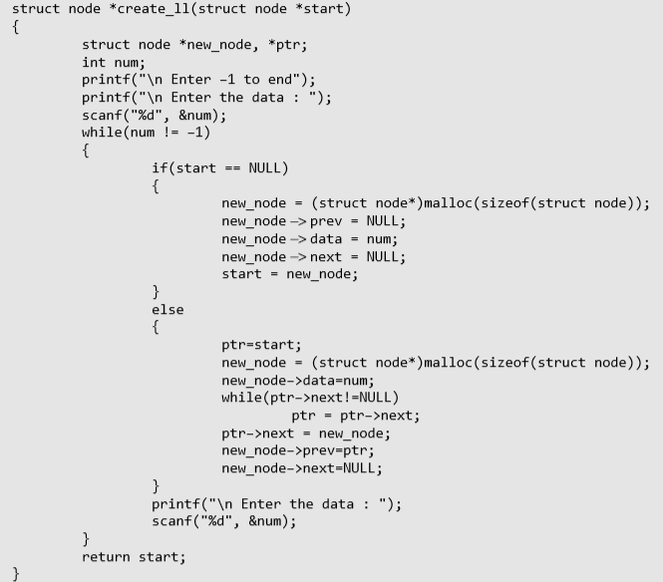
Doubly Linked Lists

Slide 35
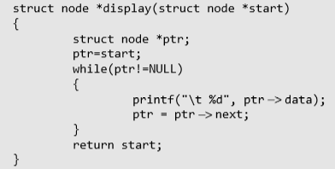
Doubly Linked Lists

Slide 36
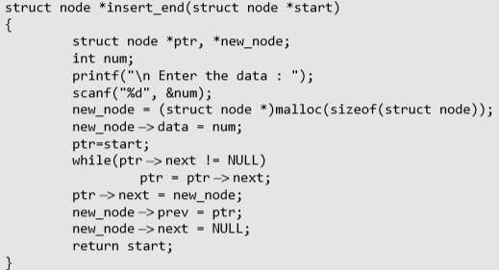
Doubly Linked Lists

Slide 37
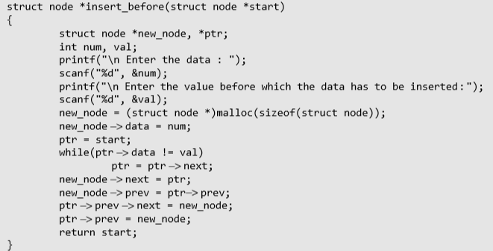
Doubly Linked Lists

Slide 38
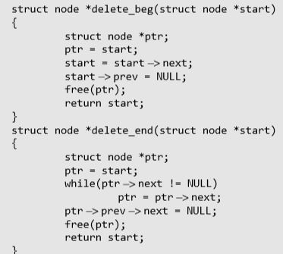
Doubly Linked Lists

Slide 39
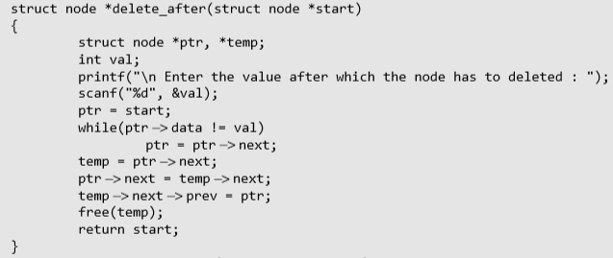
Doubly Linked Lists

Slide 40
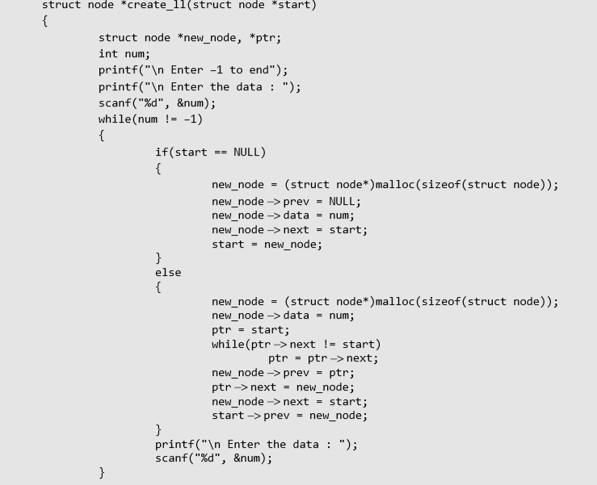
Circular Doubly Linked Lists

Slide 41
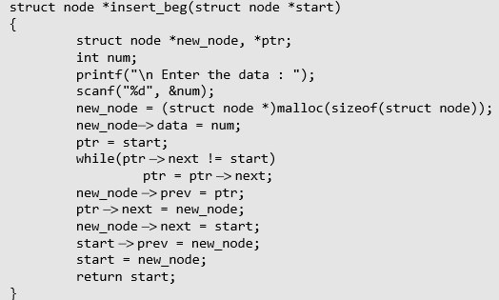
Circular Doubly Linked Lists

Slide 42
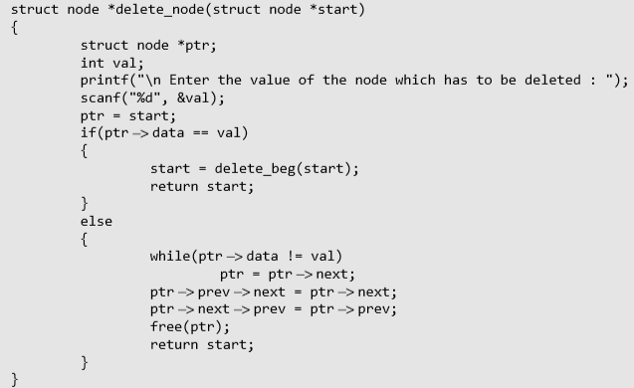
Circular Doubly Linked Lists

